Slide 1
IACS Industrial Academia Coordination system GROUP MEMBERS Muhammad Khalid SE-018 Muhammad Waqar SE-050
Internal supervisor:
Dr. Sh. Muhammad Wahab Uddin Usmani.
Industrial advisor:
Hasnain Tayyab
Software Engineering Department
NEDUET, Karachi

Slide 2
Contents
Abstract
Aims and objectives
Targeted customers
Project Output
Hardware Requirements
Software Requirements
Work division
Gantt chart

Slide 3
Abstract
Job is an essential part of our life. As we know that in our country there is lack of job availability. One of the reasons is industries are fewer job vacancies and another is a lack of awareness.
All kinds of these problems occur due to a lack of communication between undergraduates and industries.
Industrial academia coordination system would try to overcome the gap so peoples can get their desired job.

Slide 4
Major Problems
Students facing difficulties to find their first jobs.
Difficulties to find projects sponsors.

Slide 5
Aims & objectives
To overcome the gap between industries and universities.
To provide quality employees to industries.
To help students to find job based on their skills

Slide 6
Targeted customers
Students can use it to find jobs, internships, scholarship and project funding.
Industries can find their targeted employs that are perfect for their jobs

Slide 7
Project Output
Students can find their academic career.
They can polish their skills working with industries in academic session.
They can find the sponsors for their projects.

Slide 8
Hardware Requirements
A desktop, pc laptop for development.
A server, domain and hosting for host the sites.

Slide 9
Software Requirements
Languages / Framework:
JavaScript's
React js
Node js
Software:
VS code
MySQL

Slide 10
Departmental Mission & SDGs.
The responsibility of the software engineer is to provide solutions to social problems, not only automate the system. The motive of the industrial academia corporation system is to overcome the gap between industry and students. It can help to solve the job problem faced by every undergraduate student after the degree. In our country poverty is very high which can only be solved by jobs and that’s what we are trying to do.

Slide 11
SDGs (Sustainable Development Goals)
No Poverty
Gender Equality

Slide 12

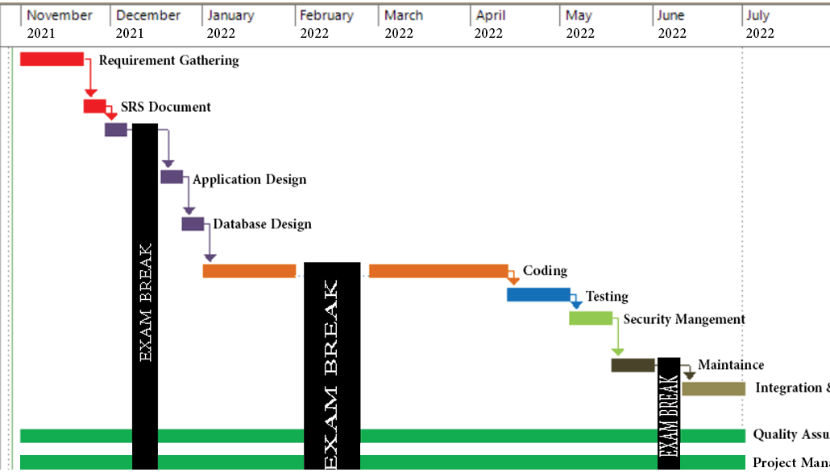
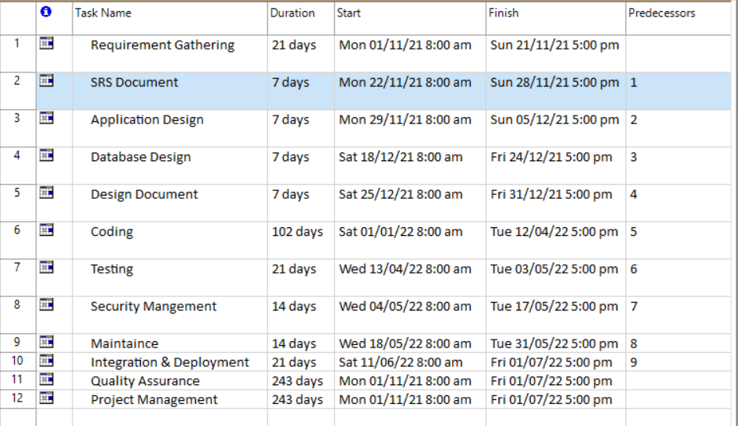
Project Milestone

Slide 13
Work Division
KHALID
Home Page
Student Dashboard Sign In Page
Backend Developments
DEPLOYMENT
Security Checkups
WAQAR
INDUSTRIAL DASHBOARD SIGN UP PAGE
RATIONAL DATABASE DESIGN
Database Integration with Institute
TESTING
Other Features are equally distributed as specified by the client

Slide 14
Thanks For Your Listening

